Slide 1
Propel
Innovation enabled

Slide 2
Deutsche Account – ‘Working Modes’
Mode2: Digital Transformation
Mode3: Innovation
Mode1: Day to day Run/Change portfolio on the DB Account (DLS and existing pipeline)
Mode2: Digital Transformation work supported by technologies DXC has already with a go-to-market capability (Workplace efficiency, OCR/ICR, Records Mgmt)
Mode3: Innovation in very early stages and needs focus to produce impact for the client and drive value for DXC (Semmle for *IBOR remediation, VeridiumID)
Mode1: Run
NB: Proportions are
illustrative only!

Slide 3
Deutsche Account – ‘Changing Modes’
Mode2: Digital Transformation
Experiment to Scale: This needs the full innovation pipeline implemented. Ideation, incubation, acceleration, transformation and scale. Rigour around tollgates and funding. Star chambers to green-light experiments. Happily we have an operating model for how this could work and much of the ecosystem in place to leverage it.
We just need to start!
Mode3: Innovation
Mode1: Run
Transformation to MVP: We could re-invigorate a number of these initiatives by drawing them out of Mode2 and back into Mode3, pare them back and build functioning experiments in conjunction with the client in DBLabs, the London Innovation Centre (LIC) or the Digital Enablement Lab (DEL) This would bring the solution to life, elicit a dialogue with the client, deepen our understanding of their issues or areas of focus and increase trust in DXC and our ability to deliver
NB: Proportions are
illustrative only!

Slide 4
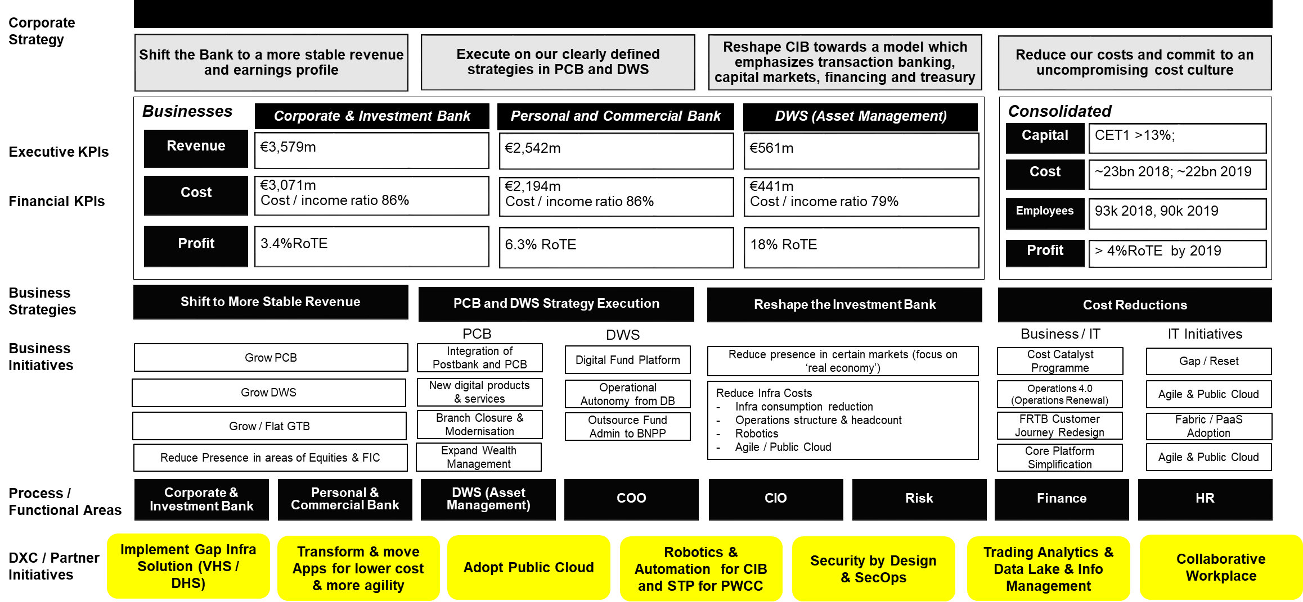
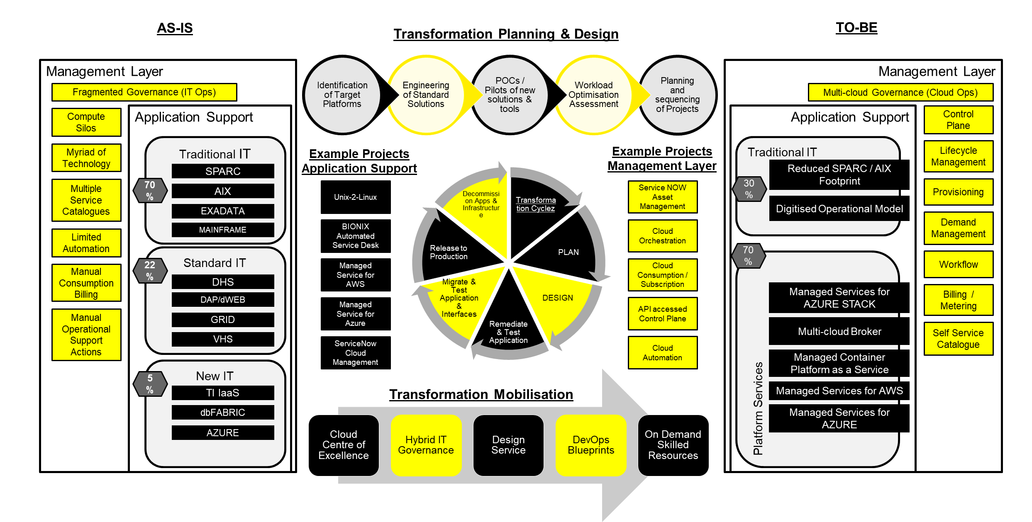
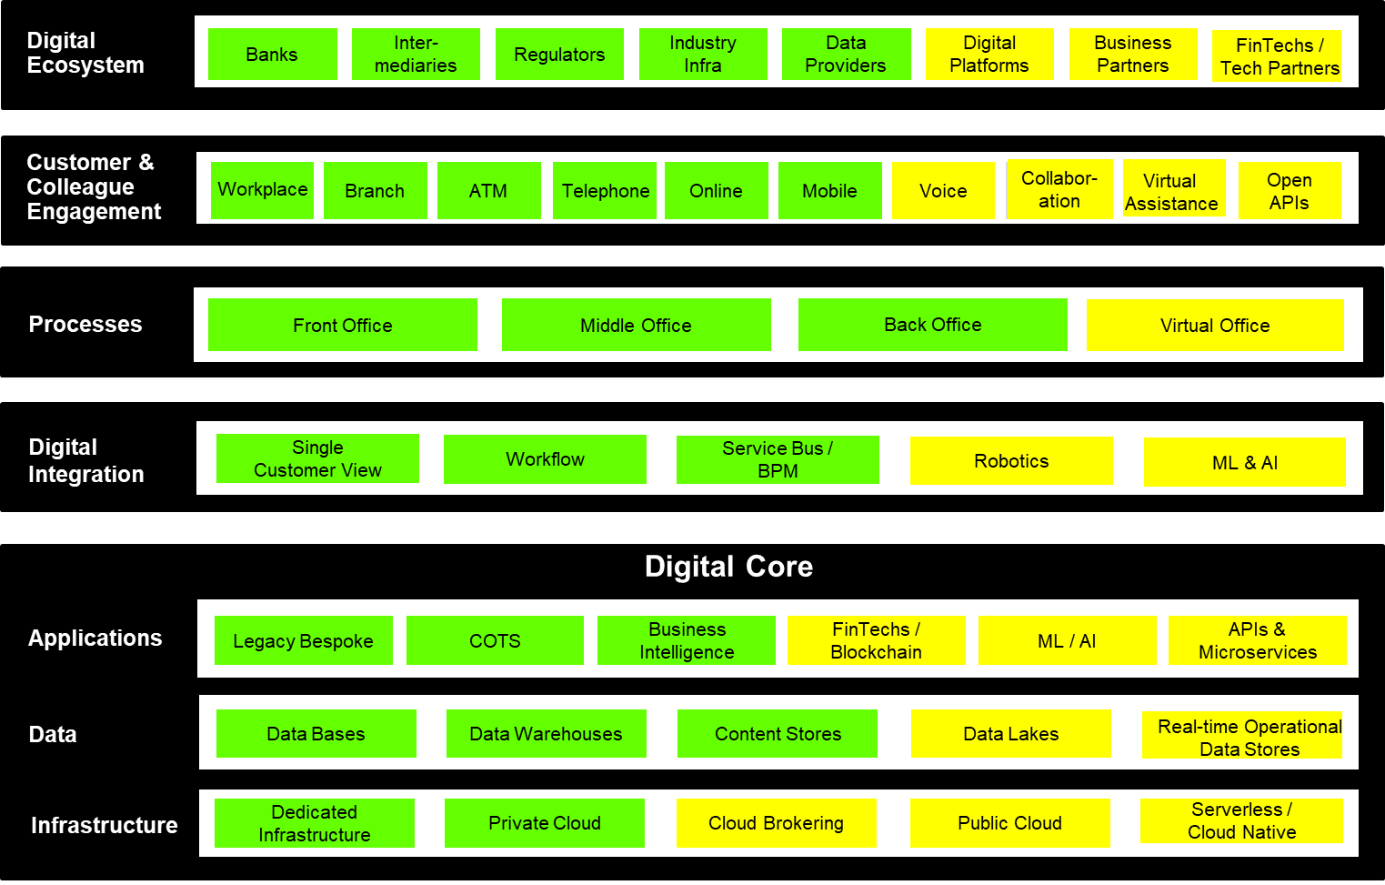
Where Propel sits in the DB Account
Propel
DXC / Client Innovation Ecosystem
Policies
Deutsche Bank
Standards
Strategy
Deutsche BVF
DXC Initiatives
inform
Domain Runbooks
T-Maps
Sales Plan
Account Technical Strategy / Principles
Stakeholder
Map
Sales Strategy
Proposal POD
Technical Risk Register
SFID
Client Value Board

Slide 5
Making Propel work
Governance and Communication (Propel Council)
Demand
Supply
Transformation
Key Steps
Proactively Engage, Inform and Coach Client Innovation leads
(being done)
Ideas documented in backlog for further assessment
(3-day sprints)
Medium to high fidelity prototypes, assessed, tested with users
(3-week or 3-month sprints)
Extensive market testing of concepts & prototype testing production systems
(Transitional)
Product is scaled and rolled out to market(s) in with end owner
(Commercially GTM-ready)
Engage & Inform [2/5]
Ideate and Qualify [1/5]
Experiment [1/5]
Accelerate [0/5]
Scale [0/5]
Ideation Funnel
Answering the ‘WHAT”: Ideas are prioritized, tested and finalized as they go through the funnel
Explore / challenge
Build > test > learn
Build > test > learn
Build > test > learn
(DXC + Client)
(DXC)
(DXC + Client via LIC or DEL)
(Transition to Client or build to
scale in DXC for wider leverage)
(Informs Corporate supply chain
or offering family for re-use)
Volume of
Experiments
Quality Assurance and Value Attainment
Clarity around
Client/DXC Value
Research and DXC SME Insight
Partnerships and Ecosystem Support
New Technology and Strategic Partner R&D
Startup/xTech Community Insight & Management
Kill or Keep stage gates

Slide 6
Propel – next steps
Jun
What’s next…?
Formalise the Propel Council (Light ToR, authority and accountability, attendees, schedule) ✅
Formal approval for Propel expenditure to be sought from Investment Board ✅
Improve the links into DXC Innovation ecosystem – needs to become frictionless and repeatable ⚠️
Build connections into the Client Innovation community / DBLabs ❌
Drive the existing Fintech/Startup engagement model into consumable tech/insight ⚠️
Raise the profile and increase visibility of the pipeline in DXC and within the client ✅
Leverage the ‘Spark Innovation’ platform within DXC for additional opportunity ❌
Regulator engagements? ✅

Slide 7
Introducing Propel for Deutsche Bank
How we hold ourselves accountable for the outcomes of the innovation agenda
1
Focused pipeline management
Experiments transparently managed (platform tbc) and regularly reviewed by the Propel Council ensuring they align with strategic business objectives outlined in the Client Business Value Framework
5
Outcome obsessed
We are clear from the start what success will look like and will agree accountability to scale and realise benefits as part of the idea development process
2
Work must be problem-specific and user focused
We will put the Client at the centre of every initiative that is put forward and we must be able to stipulate ‘What specifically is the problem we are trying to solve?”
6
An iterative, flexible process
Things change. We will remove unnecessary work and quickly move to finalized propositions by using repeatable steps in a simple to follow plan
3
Emphasis on validated learnings
Diligence in the early phase of an experiment pays off – the Propel Council will assess every proposal with 3 lenses – client desirability, business applicability and technology feasibility (subject to ratification by Council)
7
Effective multi-disciplinary teams
A joint sales, technology and innovation team with multidisciplinary skills, each with a stake in the outcome of the experiment, will remain involved from start to finish, not just for one phase of the project.
4
Fail well
Not all experiments succeed and some won’t proceed. We have stage gates that are placed at the most strategic points of the process to validate investments and support fact and outcome-based decision making
8
A methodology that will continue to evolve
Every project is executed better than the one before. Continuous learning and improvement is a key facet of our approach, with post-mortems, reviews, and feedback built into the process.

Slide 8
Supporting Information

